Slide 1
Multiple Access Techniques II
Course Code: CSC 3116
Course Title: Computer Networks
Dept. of Computer Science
Faculty of Science and Technology
Lecturer No: | 4 | Week No: | 4 | Semester: | Fall 24-25
Lecturer: | Dr. Mehedi Hasan; mmhasan@aiub.edu

Slide 2
Lecture Outline
ALOHA
CSMA
CSMA/CD
CSMA/CA

Slide 3
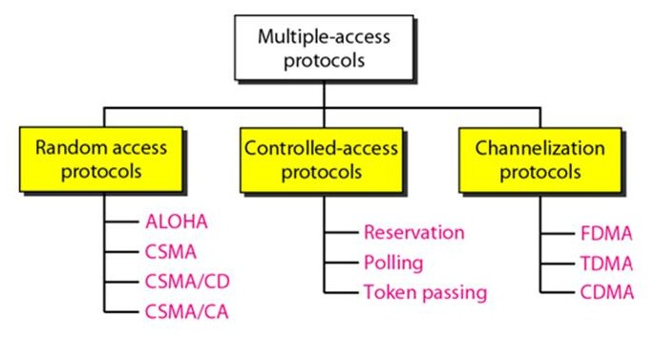
Introduction….
Fig. 1 Classification of multiple access protocols

Slide 4
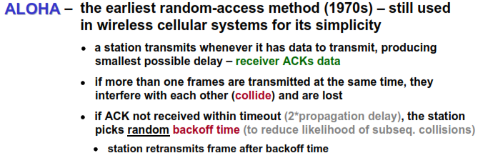
ALOHA
Introduction
ALOHA originally stood for Additive Links On-line Hawaii Area

Slide 5
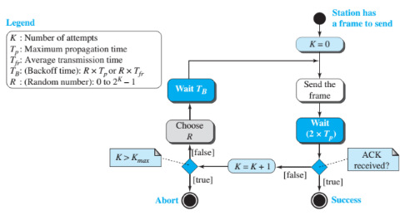
Pure ALOHA
The original ALOHA protocol is called pure ALOHA.
This is a simple but elegant protocol.
The idea is that each station sends a frame whenever it has a frame to send (multiple access).
Since there is only one channel to share, there is the possibility of collision between frames from different stations.
Fig. 1 Flow chart of ALOHA

Slide 6
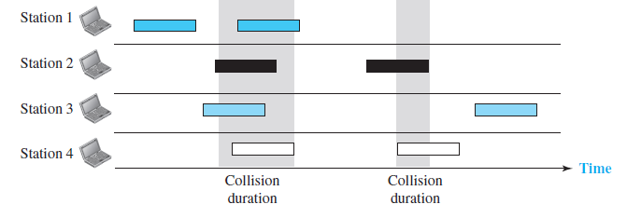
Pure ALOHA
Figure: Frames in a pure ALOHA network

Slide 7
Pure ALOHA
The pure ALOHA protocol relies on acknowledgments from the receiver.
When a station sends a frame, it expects the receiver to send an acknowledgment.
If the acknowledgment does not arrive after a time-out period, the station assumes that the frame (or the acknowledgment) has been destroyed and resends the frame.

Slide 8
Pure ALOHA
A collision involves two or more stations.
If all these stations try to resend their frames after the time-out, the frames will collide again.
Pure ALOHA dictates that when the time-out period passes, each station waits a random amount of time (backoff time) before resending its frame.
The randomness will help avoid more collisions

Slide 9
Pure ALOHA
Pure ALOHA has a second method to prevent congesting the channel with retransmitted frames.
After a maximum number of retransmission attempts K_{max}, a station must give up and try later.
The time-out period is equal to the maximum possible round-trip propagation delay, which is twice the time required to send a frame between the two most widely separated stations (2 × Tp).
Fig. 1 Flow chart of ALOHA

Slide 10
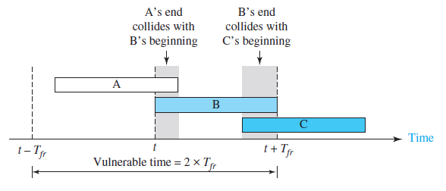
Pure ALOHA
Let us find the vulnerable time, the length of time in which there is a possibility of collision.
We assume that the stations send fixed-length frames with each frame taking T_{fr} seconds to send

Slide 11
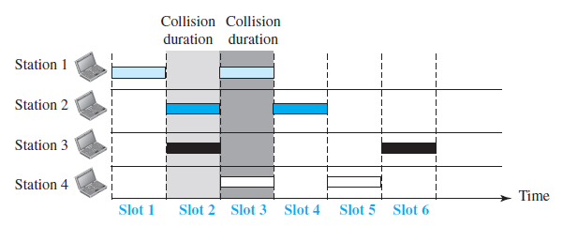
Slotted ALOHA
Pure ALOHA has a vulnerable time of 2 × Tfr. This is so because,
There is no rule that defines when the station can send.
A station may send soon after another station has started or just before another station has finished.
Slotted ALOHA was invented to improve the efficiency of pure ALOHA.
In slotted ALOHA we divide the time into slots of T_{fr} seconds and force the station to send only at the beginning of the time slot.
Figure: Frames in a slotted ALOHA network

Slide 12
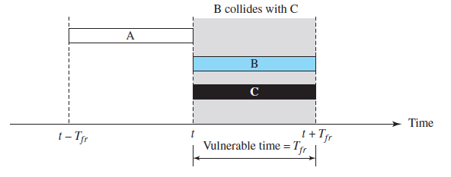
Slotted ALOHA
The vulnerable time is now reduced to one-half, equal to T_{fr}
Figure: Vulnerable time for slotted ALOHA protocol

Slide 13
Carrier Sense Multiple Access
Introduction
CSMA was developed to overcome the problems of ALOHA i.e. to minimize the chances of collision.
CSMA is based on the principle of “carrier sense”.
The station sense the carrier or channel before transmitting a frame.
It means the station checks whether the channel is idle or busy.
The chances of collision reduces to a great extent if a station checks the channel before trying to use it.
Fig. 4 Flow chart of CSMA

Slide 14
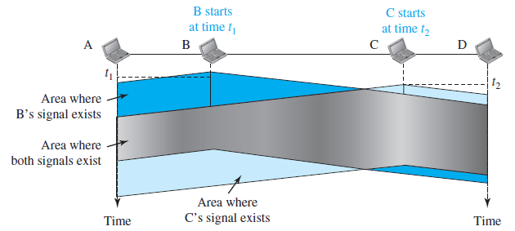
Carrier Sense Multiple Access
CSMA
The chances of collision still exists because of propagation delay.
The frame transmitted by one station takes some time to reach the other station.
In the meantime, other station may sense the channel to be idle and transmit its frames.
This results in the collision.
Figure: Space/time model of a collision in CSMA

Slide 15
Carrier Sense Multiple Access
Classification
What should a station do if the channel is busy? What should a station do if the channel is idle?
Three methods have been devised for CSMA:
1-persistent method,
the nonpersistent method
the p-persistent method

Slide 16
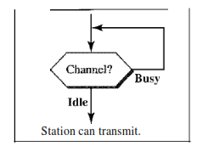
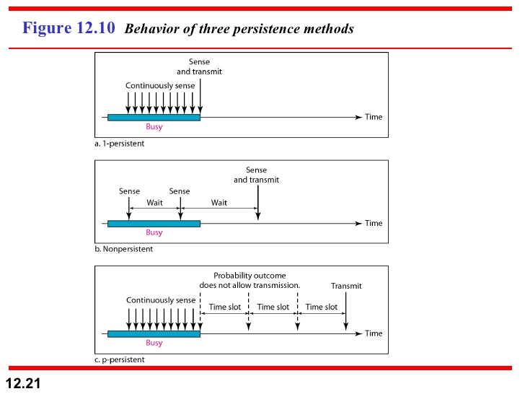
Carrier Sense Multiple Access
1-persistent
1-Persistent: The 1 (one) -persistent method is simple and straightforward. In this method, after the station finds the line idle, it sends its frame immediately (with probability 1).
This method has the highest chance of collision because two or more stations may find the line idle and send their frames immediately.
Fig. 5 Carrier sense in 1-persistent
Fig. 6 Flow chart of 1-persistent

Slide 17
Carrier Sense Multiple Access
Nonpersistent
Nonpersistent: In the nonpersistent method, a station that has a frame to send senses the line. If the line is idle, it sends immediately. If the line is not idle, it waits a random amount of time and then senses the line again.
The nonpersistent approach reduces the chance of collision because it is unlikely that two or more stations will wait the same amount of time and retry to send simultaneously.
However, this method reduces the efficiency of the network because the medium remains idle when there may be stations with frames to send.

Slide 18
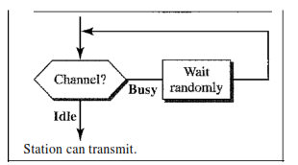
Carrier Sense Multiple Access
Nonpersistent
Fig. 7 Carrier sense in nonpersistent
Fig. 8 Flow chart of nonpersistent

Slide 19
Carrier Sense Multiple Access
P-Persistent
p-Persistent: The p-persistent method is used if the channel has time slots with a slot duration equal to or greater than the maximum propagation time. The p-persistent approach combines the advantages of the other two strategies. It reduces the chance of collision and improves efficiency.
In this method, after the station finds the line idle it follows these steps:
1. With probability p, the station sends its frame.
2. With probability q = 1 - p, the station waits for the beginning of the next time slot and checks the line again.
a. If the line is idle, it goes to step 1.
b. If the line is busy, it acts as though a collision has occurred and uses the back­ off procedure.

Slide 20
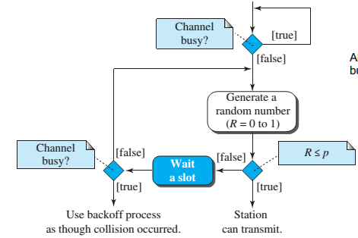


Carrier Sense Multiple Access
P-Persistent
How to calculate P?
where N is the number of stations that are connected to the shared medium
Fig. 9 Carrier sense in p-persistent
Fig. 10 Flow chart of p-persistent

Slide 21
CSMA/CD
In CSMA/CD, the station that sends its data on the channel, continues to sense the channel even after data transmission.
If collision is detected, the station aborts its transmission and waits for a random amount of time & sends its data again.
As soon as a collision is detected, the transmitting station release a jam signal.
Jam signal alerts other stations. Stations are not supposed to transmit immediately after the collision has occurred.
Fig. 11 Flow chart of CSMA/CD

Slide 22
CSMA/CA
Introduction
Carrier sense multiple access/collision avoidance (CSMA/CA) protocol is used in wireless networks because they cannot detect the collision.
So, the only solution is collision avoidance.
Worked based on three strategies
Inter Frame Space
Contention Window
Acknowledgements
Fig. 12 Flow chart of CSMA/CA

Slide 23
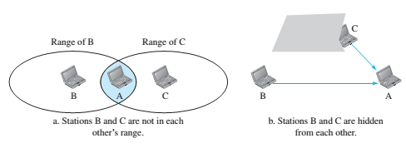
CSMA/CA
Introduction
Wireless Networks
CSMA/CA is used. CSMA/CD cannot be used because
CSMA/CD requires continuous transmission and reception for collision detection. Thus require full-duplex operation, which can not be supported in wireless due to short battery life
Difficult to detect may not be detected because of obstacle or range problem
The distance between stations can be great. Signal fading could prevent a station at one end from hearing a collision at the other end.
Fig. 13 Illustration of difficulties
in collision detection in wireless
networks

Slide 24
Topic Heading..
Topic sub heading..
This protocol is used in wireless networks because they cannot detect the collision.
So, the only solution is collision avoidance.
It avoids the collision by using three basic techniques:
Interframe Space (IFS)
Contention Window
Acknowledgements

Slide 25
CSMA/CA
Interframe Space
Whenever the channel is found idle, the station does not transmit immediately.
It waits for a period of time called Interframe Space (IFS).
When channel is sensed idle, it may be possible that some distant station may have already started transmitting.
Therefore, the purpose of IFS time is to allow this transmitted signal to reach its destination.
If after this IFS time, channel is still idle, the station can send the frames

Slide 26
CSMA/CA
Contention window
Contention window is the amount of time divided into slots.
Station that is ready to send chooses a random number of slots as its waiting time.
The number of slots in the window changes with time.
It means that it is set of one slot for the first time, and then doubles each time the station cannot detect an idle channel after the IFS time.
In contention window, the station needs to sense the channel after each time slot [1].

Slide 27
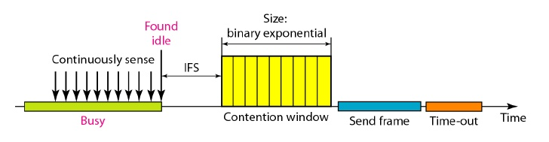
CSMA/CA
Acknowledgement
Despite all the precautions, collisions may occur and destroy the data.
Positive acknowledgement and the time-out timer helps guarantee that the receiver has received the frame.
Fig. 14 Carrier sense in contention window

Slide 28
References
[1] B. A. Forouzan, Data Communication and Networking, 5th ed., The McGraw-Hill Companies, Inc., USA, 2013, pp. 326-339.

Slide 29
Recommended Books
Data Communications and Networking, B. A. Forouzan, McGraw-Hill, Inc., Fourth Edition, 2007, USA.
Computer Networking: A Top-Down Approach, J. F., Kurose, K. W. Ross, Pearson Education, Inc., Sixth Edition, USA.
Official Cert Guide CCNA 200-301 , vol. 1, W. Odom, Cisco Press, First Edition, 2019, USA.
CCNA Routing and Switching, T. Lammle, John Wily & Sons, Second Edition, 2016, USA.
TCP/IP Protocol Suite, B. A. Forouzan, McGraw-Hill, Inc., Fourth Edition, 2009, USA.
Data and Computer Communication, W. Stallings, Pearson Education, Inc., Tenth Education, 2013, USA.

